Slide 1
Building new boxes

Slide 2

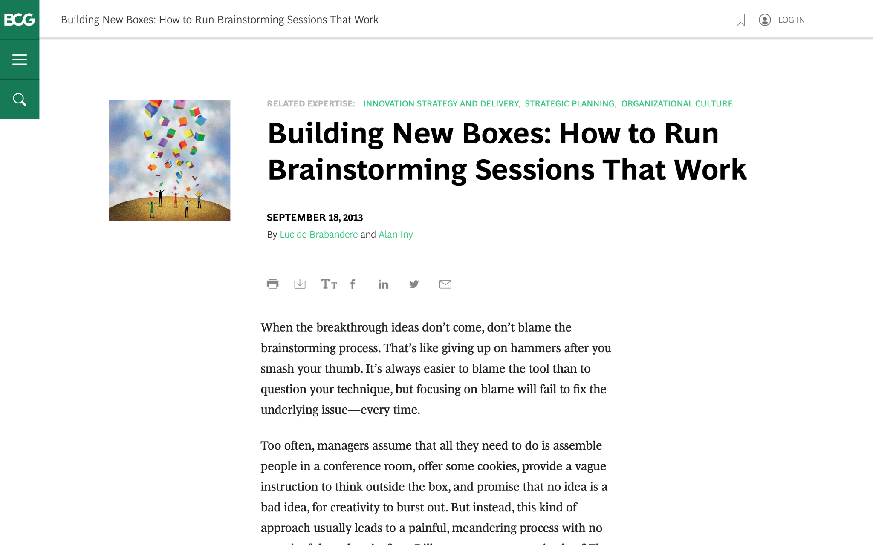
We are going to discuss effective brainstorming. Start by reviewing this article on the BCG website:
Building New Boxes: How to Run Brainstorming Sessions That Work

Slide 3

The article offers five suggestions to achieve real, valuable insights from brainstorming
We will focus on three of these in today’s task (as well as the brainstorming itself), highlighted in green
1.
Frame the question effectively
2.
Create creativity conditions
3.
Reveal and doubt your boxes
4.
Bring new boxes
5.
Follow up
Brainstorm

Slide 4

Your task
BCG has been brought in to help ClothingCo, a luxury clothing brand, grow their top line (i.e., increase revenue) after a period of declining sales.
The client is gearing up for the winter season. Imagine that you are a strategy consultant working on the project.
You will enter your responses in the green boxes throughout the remaining slides.

Slide 5
Frame the question effectively
Question to be reframed
How could we sell more outerwear this winter season?
–
Revised, effective questions:
What are the first choice of different age group?
What type of outerwear are in trend?
What kind of creative changes we can do to attract our targeted audience?
–
Remember: A good question for brainstorming will be narrow and concrete, so that people feel they know how to begin answering it.
“If I were given one hour to save the planet, I would spend fifty-nine minutes defining the problem and one minute resolving it.”
– Albert Einstein

Slide 6
Reveal and doubt your boxes
In this fictional scenario, make assumptions that seem reasonable
–
What boxes currently exist that are still relevant?
Quality of fabric
Categories for every age groups
–
What boxes currently exist that need to be doubted?
Marketing of products
Designing of products
Variety of products
The first step in the creative process entails identifying and doubting one’s current boxes and determining which ones require re-evaluation or replacement.
Make a short list of the shared beliefs and assumptions that likely prevail in ClothingCo. Determine which are still relevant and which need to be redefined.

Slide 7
Bring new boxes
New box #1
Trendy Thing
I am assuming that the sales of products are declining because company is not with the trend i.e. They are not focussing of what customer really wants.
So if they could add the trendy pattern in their outwear then it would help them to regain/achieve their customer.
New box #2
New Merchandise
Their are variety in patterns of winter outwear but their are not much design for ex when it comes to winter outwear one could only think about jacket/sweater. So if we could build something new and creative and make it audience engaging then it would definitely increase the sales of the company and it can also revolutionise the clothing industry if something good comes up.
Prepare for brainstorming by creating new boxes to bring to the session; new boxes will nurture ideation and can dramatically increase the odds of a useful result.
Remember: Defining new boxes requires a mixture of analysis and art. Boxes need to be grounded in fact. Different sectors will call for different inputs.

Slide 8
Brainstorm
Choose one of the effective questions you created on slide 5, and a new box from slide 7, and brainstorm potential ideas to address the question
Question | What kind of creative changes we can do to attract our targeted audience?
New box | Trendy Thing
We can change the designing of clothes.
We can try to put trendy quotes and incidents on outwear.
We can also try to identify the outwear pattern liked by the different age group of people.
We can also try to change/revolutionize our product.
We can also try to focus and divide the product into sub-categories to satisfy the needs of different audience.
We can also change the marketing pattern.
We can also try to be creative and create our own new product.

